Slide 1
"Phishing Attacks: Unmasking Cyber Threats and Future Countermeasures"

Slide 2
Abstract
Introduction
Literature Survey
Architecture
Methodology
Conclusion
Future Scope

Slide 3
ABSTRACT
Phishing attacks are a critical issue in today’s cybersecurity landscape. These attacks trick users into revealing sensitive information by impersonating legitimate entities. The seminar explores the history of phishing, various techniques used by attackers, and countermeasures. We will also discuss future trends and emerging phishing techniques that exploit modern technologies like AI and machine learning.

Slide 4
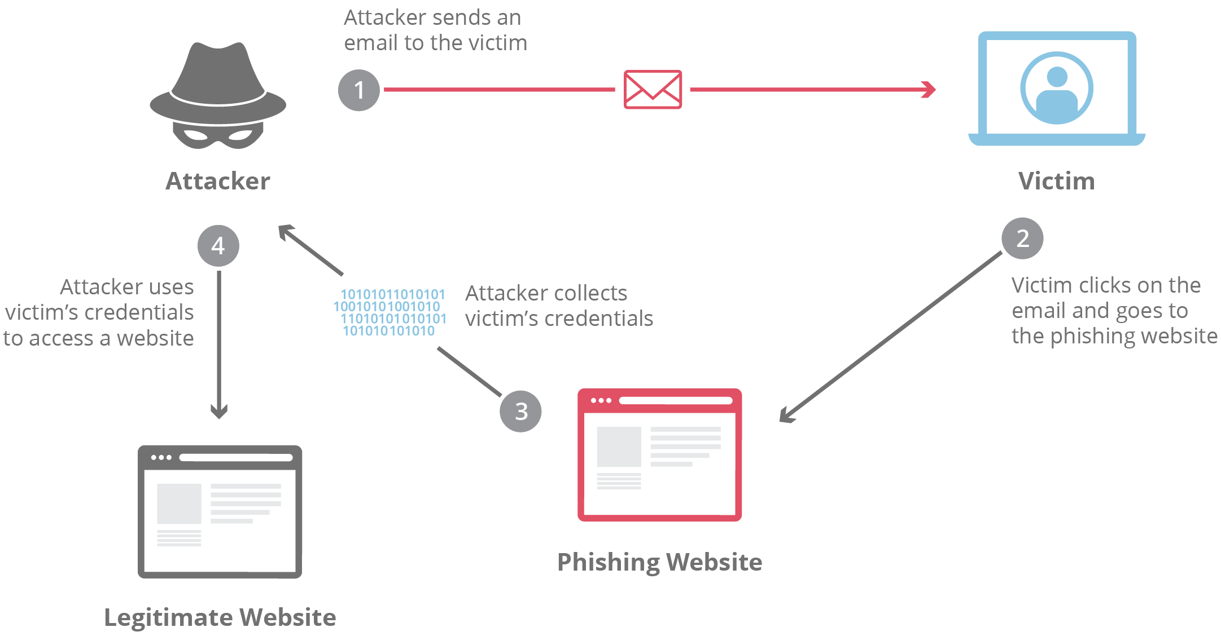
INTRODUCTION
What is Phishing?
Phishing is a cybercrime where attackers impersonate trusted organizations or individuals to steal sensitive data such as login credentials, credit card numbers, or personal information.

Slide 5
LITERATURE SURVEY
Sr No | Paper name with author | Published year | Methodology | Future Scope of Paper
1 | A survey of phishing attack techniques, defence mechanisms and open research challenges AK Jain, BB Gupta | 2022 | Phishing Attack techniues and Defence mechanism | AI-Driven Improvements Enhanced Security Measures
2 | A study on social engineering attacks: Phishing attack. AF Al-Otaibi, ES Alsuwat | 2020 | Showcasing Types of Social Engineering attacks. | Predictive algorithm and Emerging technologies for avoiding Attacks.
3 | Defending against phishing attacks: taxonomy of methods, current issues and future directions BB Gupta, NAG Arachchilage, KE Psannis | 2018 | Defence mechanism against phishing attacks | Exploitation of new technologies

Slide 6
Sr.No | Paper name with author | Published year | Methodology | Future Scope of Paper
4 | Study on Phishing Attacks Vaishnavi Bhavsar Aditya Kadlak Shabnam Sharma | 2017 | Types of Phishing Attacks and their consequences. | Deep Learning Techniques For phishing attacks.
5 | A review on recent phishing attacks in Internet Maitri Chokshi Nikhil Shah | 2015 | Showcasing Recent phishing atacks on internet | Detection and avoidance of phishing attacks

Slide 7
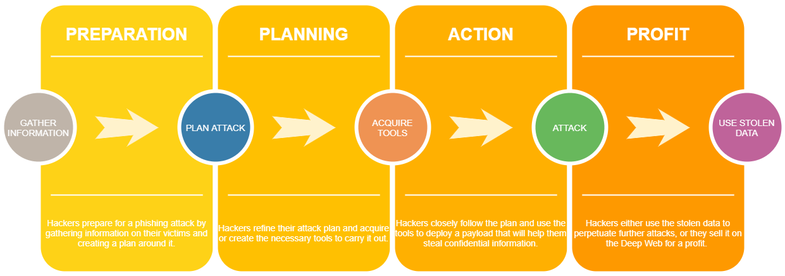
METHODOLOGY

Slide 8
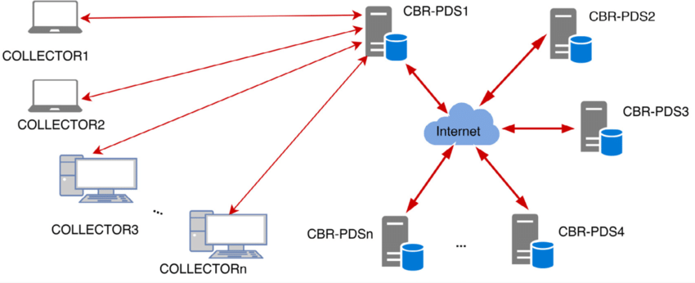
Basic architecture of Phishing Attack

Slide 9
ALGORITHMS AND TECHNOLOGY
Machine Learning Algorithm
Deep Algorithm
Random Forest Algorithm

Slide 10
Phishing Detection Technologies:
1. Email Filtering Tools: Identify and block suspicious emails before they reach users.
2. Machine Learning Models: Use AI to learn phishing patterns and flag suspicious activity.
3. Two-Factor Authentication (2FA): Requires additional authentication beyond a password, making phishing attacks less successful.
4. Domain-based Message Authentication, Reporting & Conformance (DMARC): Protects domains from being used in phishing attempts.

Slide 11
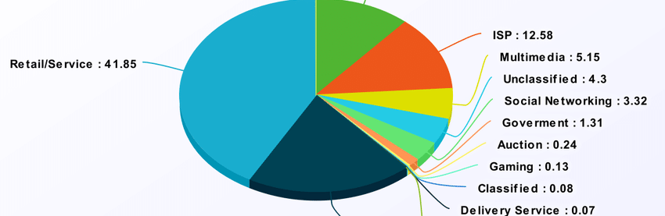
Result Analysis
Detection Efficiency:Technologies like AI-based email filtering and machine learning algorithms have shown effectiveness in reducing phishing attacks by as much as 95%.
Current Trends in Success Rates:
Phishing emails continue to have a click-through rate of approximately 4-6%, which may seem low but can have devastating impacts in large organizations.

Slide 12
FUTURE SCOPE
AI and Machine Learning:
Predictive algorithms will play a critical role in anticipating and identifying phishing attacks before they occur.
Emerging technologies like deepfake detection and natural language processing (NLP) can help combat sophisticated phishing attempts.
Cybersecurity Policies and Standards:
Governments and regulatory bodies are focusing on tightening regulations, requiring organizations to adopt stricter cybersecurity frameworks to prevent phishing attacks.
New Attack Vectors:
Phishing attacks are extending beyond email to social media platforms, SMS (smishing), and IoT devices.
Attackers may increasingly use deepfakes and AI-generated content to create more believable phishing scams.

Slide 13
CONCLUSION
For Phishing attack, there are many ways to launch the attack. Here the research focuses on developing a detection and prevention techniques so that in future the client can take necessary actions to prevent phishing attacks. In this work, various types of attacks and their prevention and detection are studied. In future, focus is to compare various tools for phishing attack prevention.
Recap the seminar by highlighting:
The growing sophistication and prevalence of phishing attacks.
The effectiveness of current detection technologies like AI and 2FA.
The need for continuous vigilance and cybersecurity awareness as phishing attacks continue to evolve.

Slide 14
REFERENCES
Gupta, B. B., Tewari, A., Jain, A. K., & Agrawal, D. P. (2017). Fighting against phishing attacks: state of the art and future challenges. Neural Computing and Applications, 28(12), 3629-3654.
Huang, H., Zhong, S., & Tan, J. (2009, August). Browser-side countermeasures for deceptive phishing attack. In 2009 Fifth International Conference on Information Assurance and Security (pp. 352-355). IEEE.
Huang, H., Zhong, S., & Tan, J. (2009, August). Browser-side countermeasures for deceptive phishing attack. In 2009 Fifth International Conference on Information Assurance and Security (pp. 352-355). IEEE.

